Slide 1


Slide 2
FireDAC Data Access Panel:
Answering Your Questions About FireDAC
Cary Jensen, Jens Fudge, and Olaf Monien

Slide 3

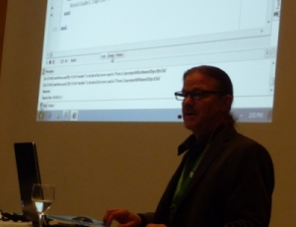

About Cary Jensen
Chief Technology Officer at The Purchasing Manager, LLC
More than 30 years experience as a developer, consultant, trainer, and mentor
Author of more than 25 books on software, including Delphi in Depth: FireDAC
Specializing in database development, application architecture, and component development
Embarcadero MVP and Spirit of Delphi recipient
Ph.D. in Engineering Psychology
Adjunct Professor in the Department of Psychological Sciences, Rice University
Email: cary.jensen@gmail.com Blog: http://caryjensen.blogspot.com/ Twitter: @caryjensen LinkedIn: https://www.linkedin.com/in/cary-jensen/
Web site: http://www.JensenDataSystems.com

Slide 4
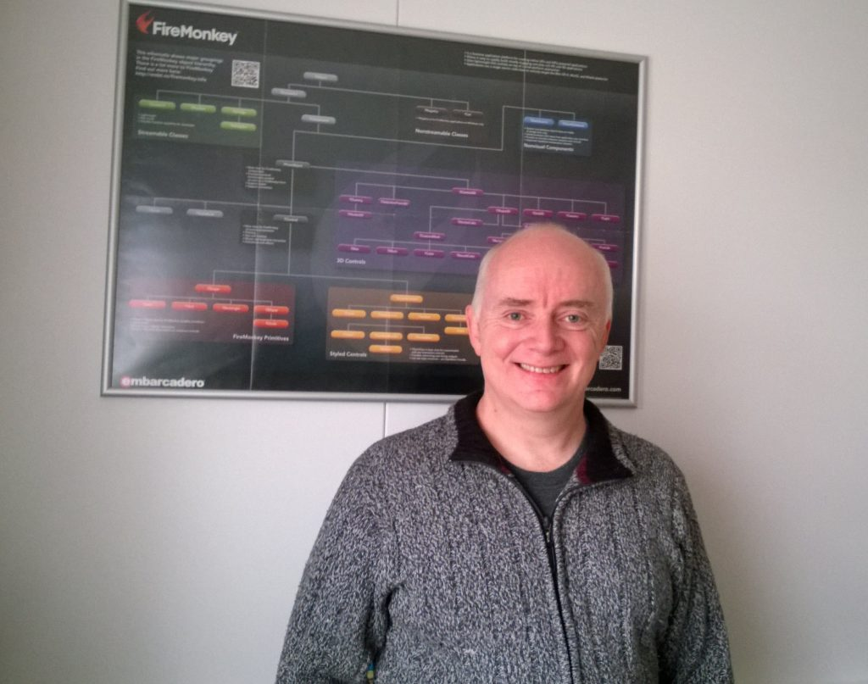
About Jens Fudge
Long time Delphi enthusiast working with Delphi since it came out in 1995
Working as a developer, trainer and consultant
Trainer at Delphi courses in Denmark, Norway and Sweden
Primarily working as consultant for various small and large companies where Delphi Expertise is required
Embarcadero MVP
Board member of DAPUG, the Danish Delphi Users Group, responsible for two workshops a year
Email: jens.fudge@archersoft.dk Blog: http://blog.archersoft.info/ Twitter: @JensFudge LinkedIn: https://www.linkedin.com/in/jensfudge/
Web site: http://www.archersoft.dk/

Slide 5
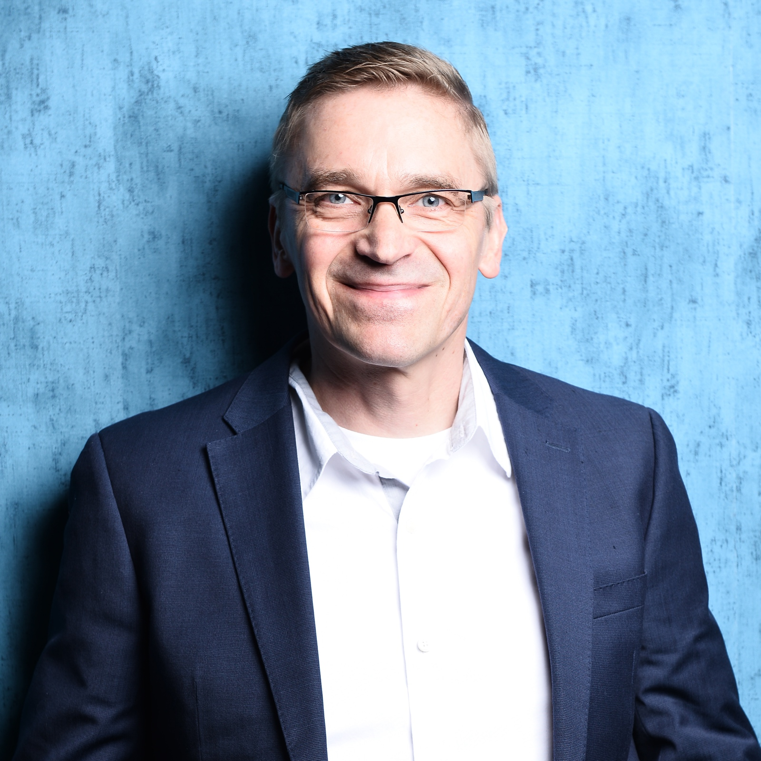
About Olaf Monien
Olaf Monien is the CEO of Developer Experts, LLC, and Unternehmensberatung Monien, which offer software development consulting services worldwide.
His areas of particular interest are software architecture, database design, Internet applications, and mobile devices.
Olaf Monien received a Master of Computer Science degree and has more than 20 years of software development experience.
Olaf Monien is Embarcadero’s MVP Coordinator for the DACH region.
Email: olaf@monien.net Blog: developer-experts.net/blog Twitter: @OMonien LinkedIn: linkedin.com/in/olafmonien
Web site: www.developer-experts.net

Slide 6
FireDAC Data Access Panel:
Answering Your Questions About FireDAC
Cary Jensen, Jens Fudge, and Olaf Monien

